Slide 1


SCHEDULER APP
BY
ELITE 4

Slide 2
ELITE 4
Members of Elite 4
Callum Moe: Database Manager / Coder / System Architecture / UI Designer / Researcher
Diego Gomez: Project Manager / Presenter / UI Designer / Writer
Michael Goldberger: Writer / Database / UI Designer / Presenter
Simeon Sabo: Primary Coder / UI designer / System Architecture / Researcher

Slide 3
TEAM FORMATION
Sim & Diego were already a team and Michael & Callum were a team. So, Michael & Diego decided to come together and form a team of 4.

Slide 4
IDEAS
MyRIC App
Scheduling App*
Mobile Version of MyRIC

Slide 5
PLAN
Started out discussing project ideas.
Talked about who could do what
Setup weekly(1-2) meeting times.
Stuck to the deadlines given to us.
Made sure everyone did their part.
Team members were available to help each other out if needed.
Team members choose days that worked for everyone.
Meetings were moved throughout the semester to ensure everyone could attend.

Slide 6
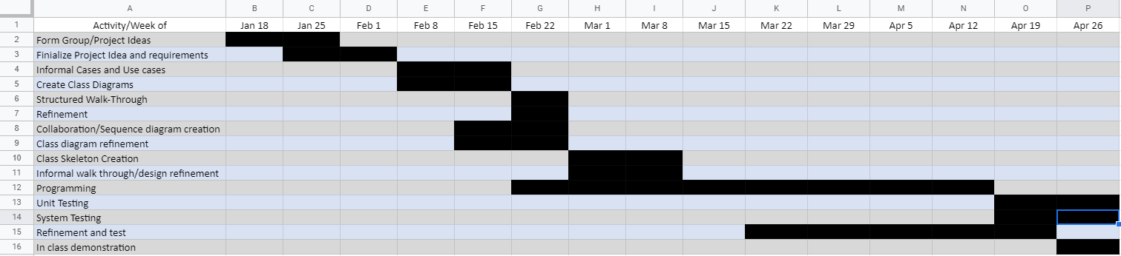
TIMELINE

Slide 7
Summary
Login and Logout functionality, basic password md5 encryption
Students can add & drop classes
Students can view their current & past classes
Admin can edit, delete or create user (Student and Professor)
Admin can edit, delete or create classes
Admin can add classes to student’s schedule
Admin can drop classes from student’s schedule
Search function can utilized by using the course/student ID or by using student’s last name and using a classes name.
Catches Scheduling errors: Time conflicts, prerequisites

Slide 8
TOOLS
Netbeans (Java) - User Interface, Primary IDE.
Eclipse (JAR) - Used to compile our JAR file.
PHPmyAdmin & XAMPP - Connecting database to UI.
Trello - Project management and Organization.
Google Drive - Uploading and organizing information.

Slide 9
DATABASE
Student
Login info
Previous Courses
Current Course
Personal info
Class info
Prerequisite
Start/end date
Professor
Other info
Professor
Classes being instructed
Personal info

Slide 10
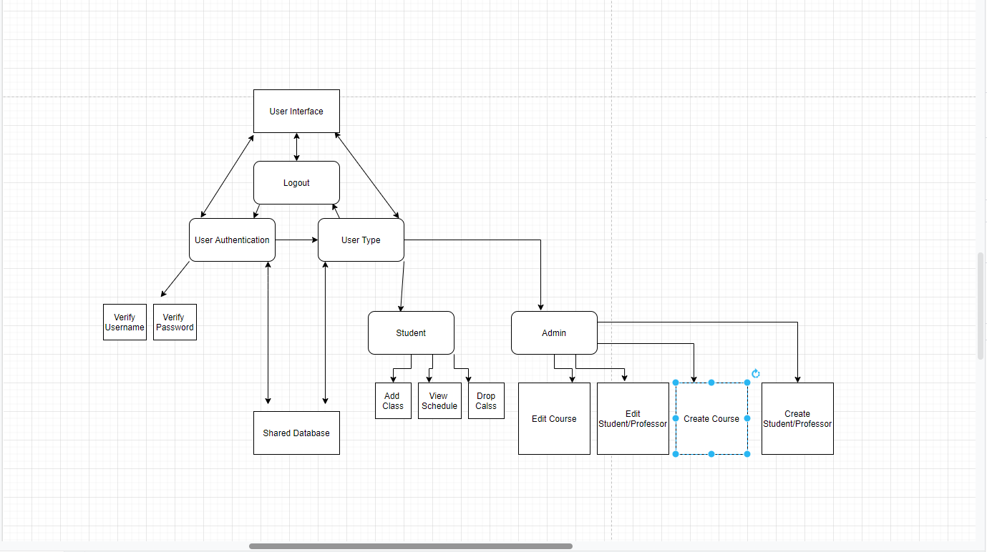
SYSTEM ARCHITECTURE

Slide 11
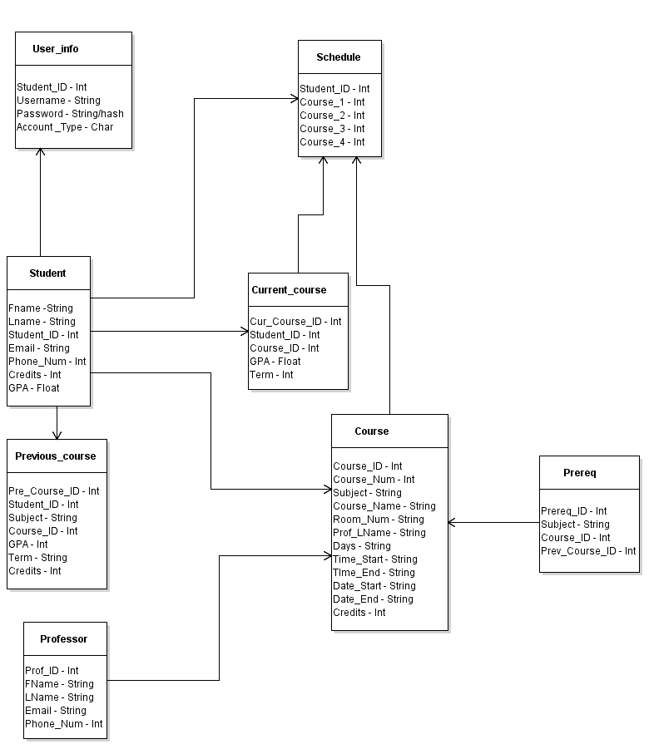
CLASS DIAGRAM

Slide 12
BLACK BOX TESTING
An error occurred when changes were made to the SQL queries for adding a course. The mistake was that the wrong database was posted to the group’s file sending service. This is an easy mistake to have occur when lots of data is changing hands quickly in a short period of time.

Slide 13
WHITE BOX TESTING
During the white box testing period, these were the errors found.
The student password change system has a security flaw where the user is prompted to enter their previous password before changing. The flaw is that the user can enter their current password in all fields and no error is detected. Modern security systems prevent the reuse of old passwords. This issue could be solved by storing the last used password and comparing.
On the Edit Student/Professor page, an error occurred where searching by a student’s ID number worked, however the Last name would throw error. This problem was resolved by deleting an extra “ ` ” (Backtick) in the java code’s query statement.

Slide 14
USER MANUAL
User Manual: https://drive.google.com/file/d/18Lw2GRzfFaT4LaUMku5Q-msrofvcCjz9/view?usp=sharing
User Manual - Pictures - https://drive.google.com/file/d/1_9f7gUGXNSgHsGfvvOTGegUx6hyFOLq0/view?usp=sharing

Slide 15
LINKS
Trello: https://trello.com/b/uaggkk1e
Drive: https://drive.google.com/drive/folders/1ZSBDtDiwwSImGf4DKnfZC8gYNx-Xfaaj?usp=sharing
Final Demo Part 1: https://drive.google.com/file/d/1ZnJCEwUxHeyikUzHGDEYqk5t0kCjYL0I/view?usp=sharing
Final Demo Part 2: https://drive.google.com/file/d/1yghrBxuaX3u58KxiQ9tUaDFVwCq7AzUf/view?usp=sharing
Instructions: https://drive.google.com/file/d/181cNH1C3RjikqyjuQUN6WsT1hnB6MqGv/view?usp=sharing

Slide 16
QUESTIONS
Does anyone have any questions?

